Slide 1







MGMT 58200
MANAGEMENT OF ORGANIZATIONAL DATA
GROUP PROJECT(1:10 SESSION)
TEAM # 1
VIDHI MOTWANI
RAJ MEHTA
MADHUR KHANNA
ALVINA PATRA
ANN MATHEW
SAMRIDHI VATS

Slide 2

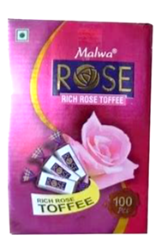


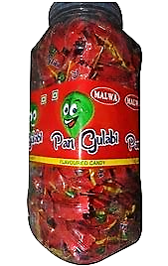

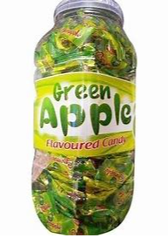



CLIENT OVERVIEW
1.
Malwa Confectionary Works (MCW), established in 1974 is a key market player in the manufacturing of a broad assortment of best quality toffee jars, toffee boxes, flavored candies and other packaged confectionary items.
These products are highly acclaimed for their high quality, nontoxic nature, long shelf life, accurate composition and rich taste and are available at several confectionary outlets in Central and Western part of India.
2.
Requirement Analysis - Business Scenario:
To enhance MCW’s current vendor management system by improving the existing database infrastructure, thereby boosting operational efficiency, facilitating strategic growth and driving potential business decisions.

Slide 3

Analysing the existing vendor, raw material and product entities, identifying data wrangling business rules to establish structured database that caters easy data manipulation and retrieval in terms of cost and efficiency mapping
Modelling the realistic spreadsheet system into optimized schema and normalizing to have a secured dynamic query-based relational database system in place
OBJECTIVES
Implementing the augmented database system to diagnose reliability of vendors, reduce raw material to product price gaps and prospect new vendors that decrease overall manufacturing cost of the products
Ensuring data integrity and scalability with relationships between entities to setup the foundation for strategic optimization

Slide 4

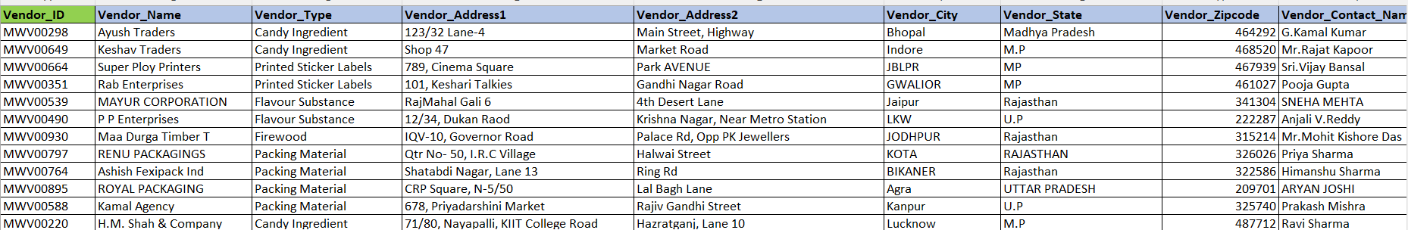
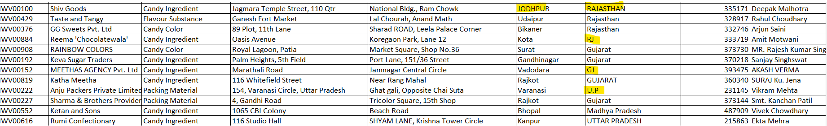





DATABASE DESIGN
Dataset Information:
We have a Vendor Management system to track vendor, raw materials that are supplied by various vendor, raw materials used for a product, raw material inventory, orders placed for raw materials in the past few months and shipping company information.
Data Wrangling:
We received raw unstructured files, on which we performed data cleansing as shown below:

Slide 5
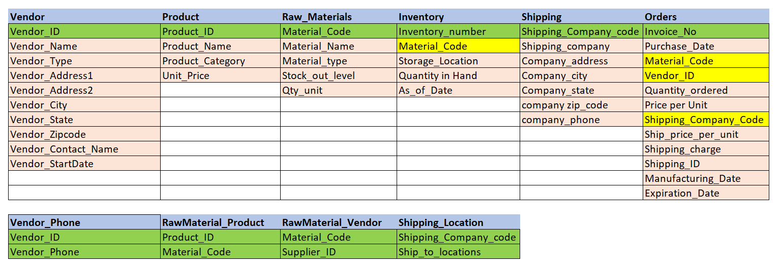
DATABASE DESIGN
Table Schema:
We received 6 base tables which further was cleansed and normalized.
Below is the list of tables normalized for the snowflake schema for our design:

Slide 6
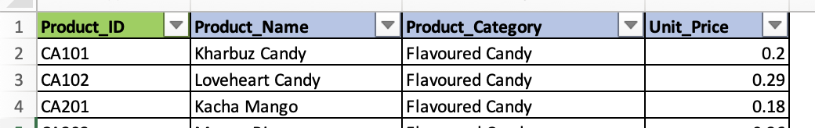
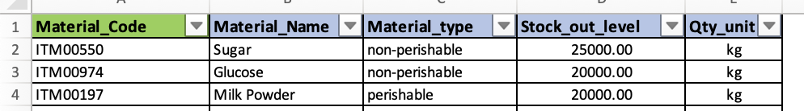
DATABASE DESIGN
Sample Data:
We established table and column naming conventions, normalized tables as part of data processing and the sample data for each table is shown as below:
Vendor (Vendor_ID is the primary key):
Product (Product_ID is the primary key):
Raw Materials (Material_Code is the primary key):

Slide 7
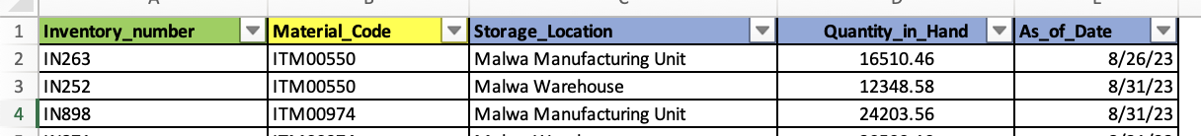
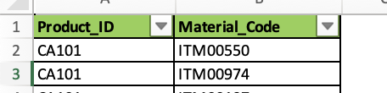
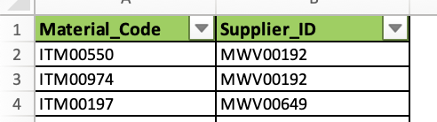
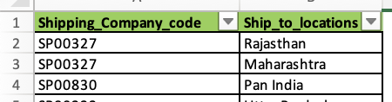
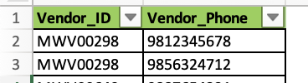
DATABASE DESIGN
Sample Data:
Inventory (Inventory_number is the primary key):
Shipping (Shipping_Company_code is the primary key):
Orders (Invoice_No is the primary key):
RawMaterial_Product
(Product_ID and Material_Code is the composite primary key):
RawMaterial_Vendor
(Material_Code and Supplier_ID is the composite primary key):
Shipping_Location
(Shipping_Company_code and Ship_to_location is the composite primary key):
Vendor_Phone
(Vendor_ID and Vendor_Phone is the composite primary key):

Slide 8

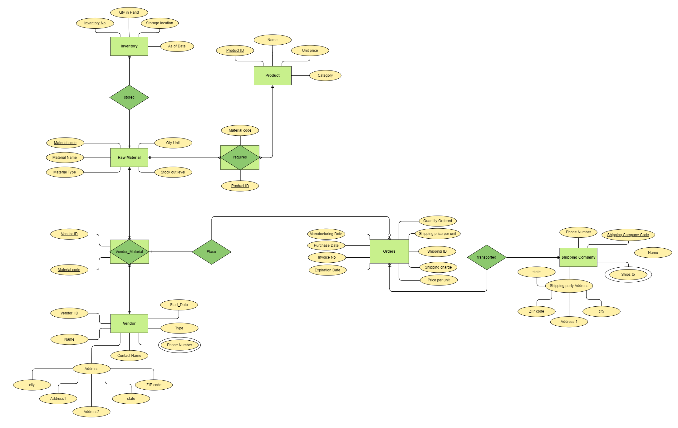
CONCEPTUAL MODELLING
Entity Relationship Diagram(ERD):
We used this graphical representation to illustrate the logical structure of a database, helping to visualize the entities, the relationships between these entities, attributes associated with each entity and the cardinality of the entities.

Slide 10
NORMALIZATION:
We performed Normalization to structure a relational database in a way that reduces redundancy and minimizes issues related to data anomalies, such as update anomalies, insertion anomalies, and deletion anomalies.
We had two tables with 0NF having multivalued attributes, which was decomposed into two separate tables in 1NF, there was no partial and transitive functional dependency and tables are in 3NF without any data anomalies:
1. Vendor to Vendor and Vendor_Phone
2. Shipping to Shipping and Shipping_Location
We had RawMaterial to Product and Vendor mapping , which was decomposed to two associative entities to handle M:M cardinality. There was no multivalued attributes, partial and transitive functional dependency. The tables are in 3NF without any data anomalies:
1. RawMaterial_Vendor
2. RawMaterial_Product

Slide 11
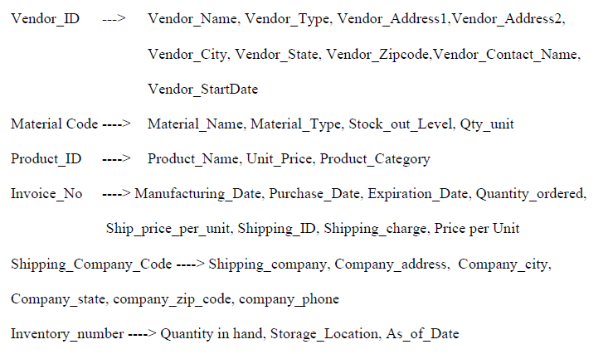
FUNCTIONAL DEPENDENCIES

Slide 12
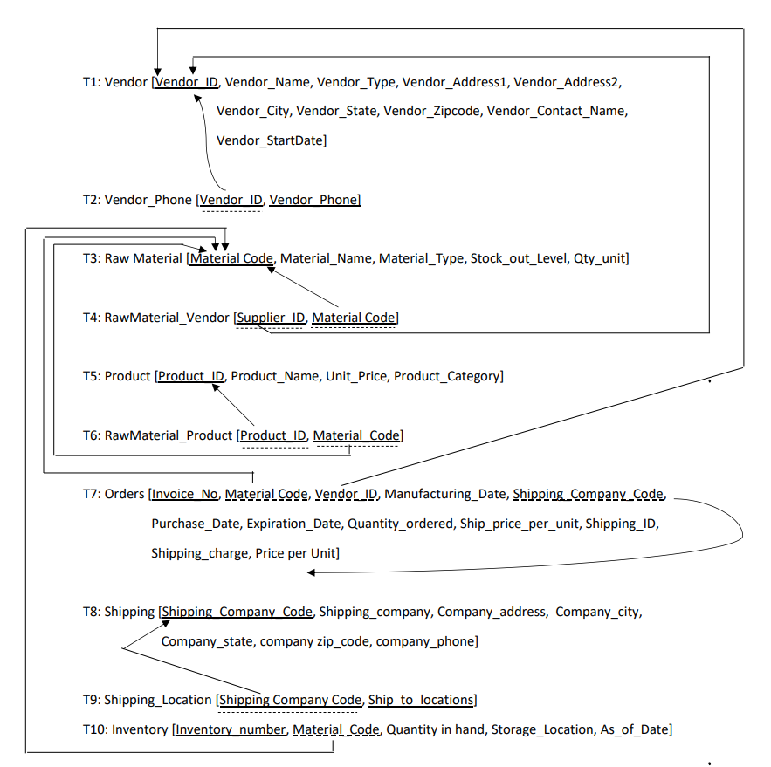
RELATIONAL MODELLING
Relational Schema :
We performed relational modelling representing relations and their relationships in the database along with preserving the integrity constraints.

Slide 13
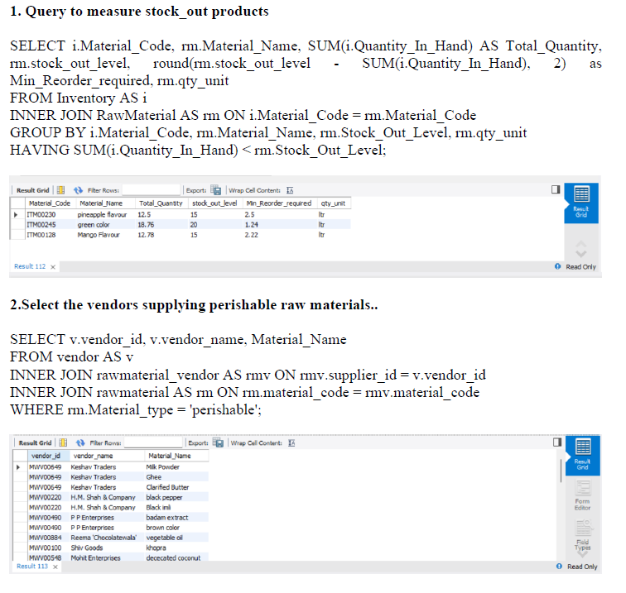
DATABASE IMPLEMENTAION
We implemented the database through SQL Queries to establish the tables and retrieve data based on the business questions:
Business Questions

Slide 14
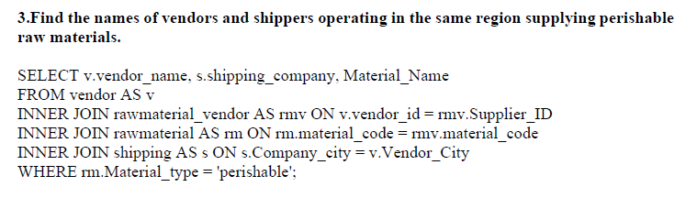
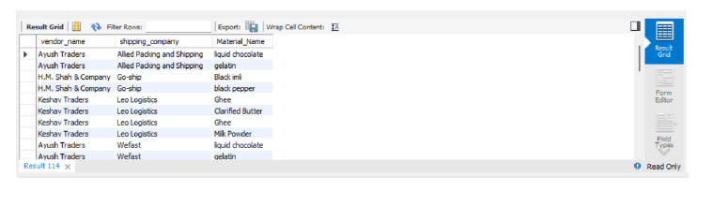

Slide 15
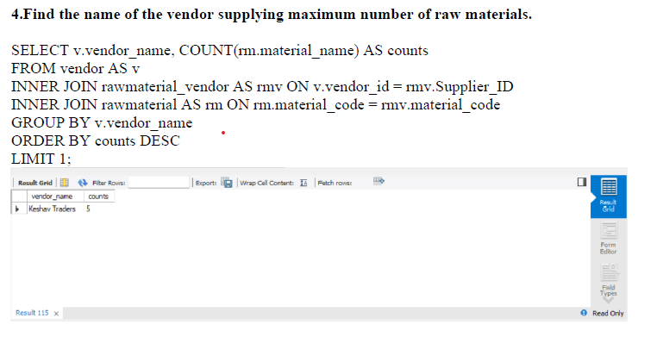

Slide 16
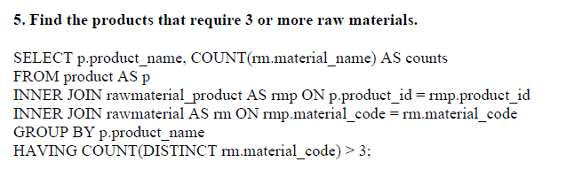
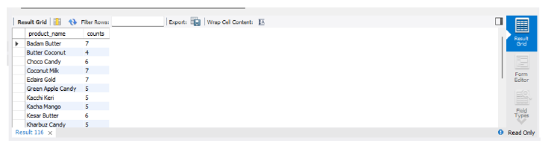

Slide 17
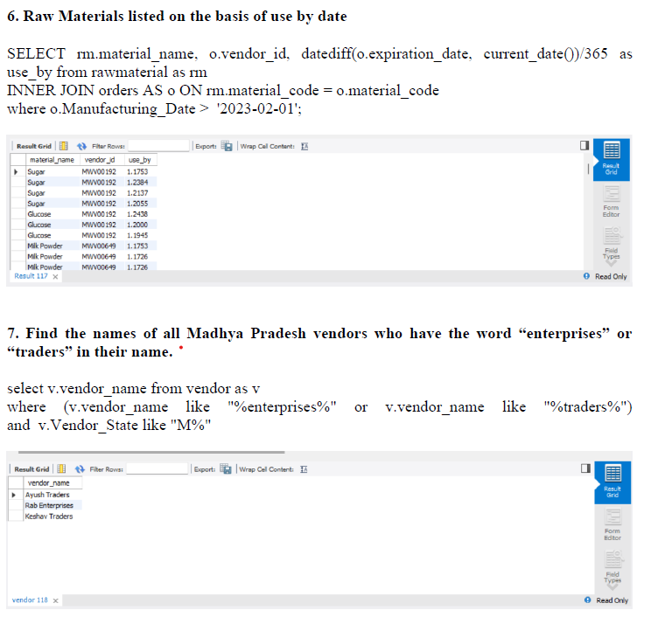

Slide 18
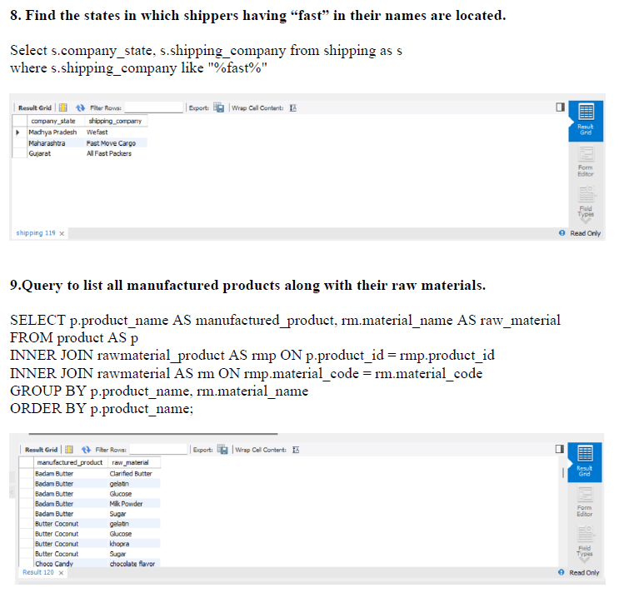

Slide 19
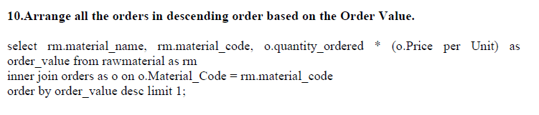
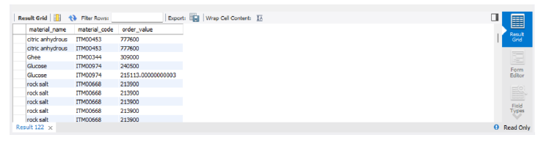

Slide 20
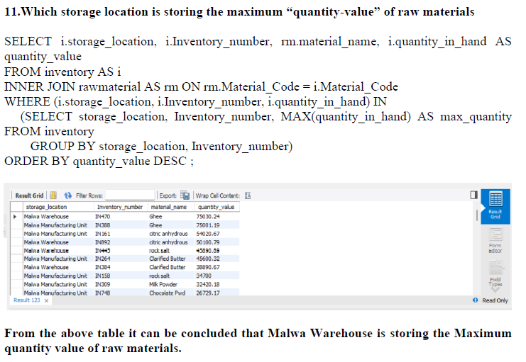

Slide 21
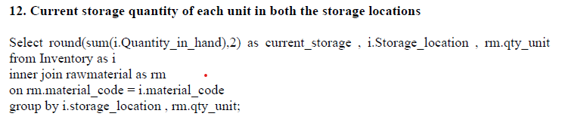
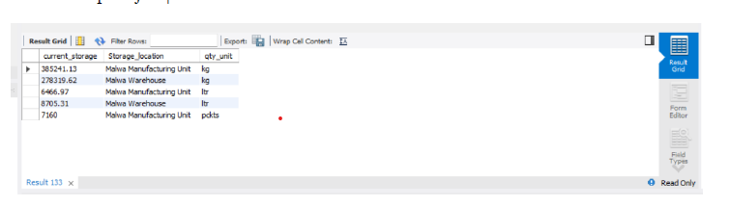

Slide 22
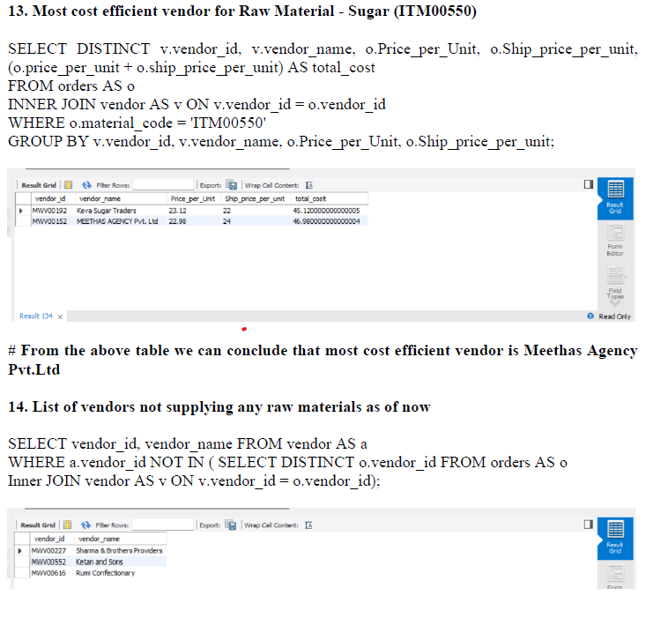

Slide 23
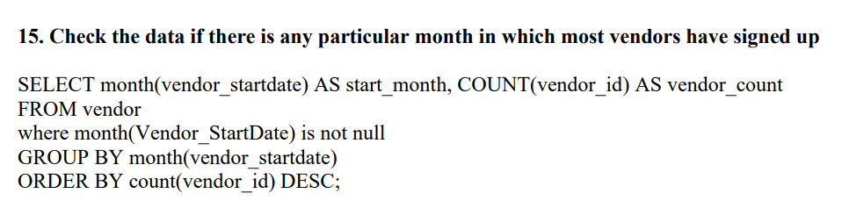
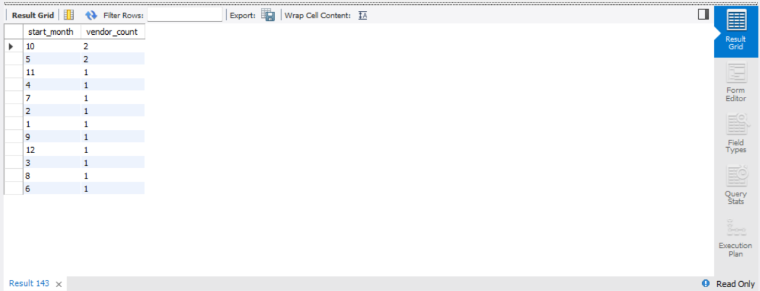

Slide 24

THANK YOU!

